Slide 1



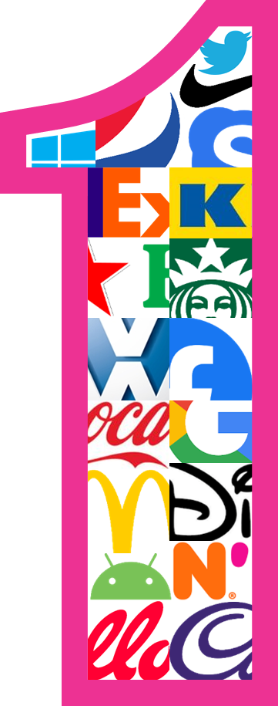
Distinctive Assets Test​
US Social Media BrandS ​
System1 Research Debrief
August 2023

Slide 2

















Brand DAT | Assets Tested
 | Colour | Slogans | Shapes | Words/Phrase
Facebook |  | "It’s Quick and Easy" |  | Status Post
Instagram |  | "Capture and Share the World’s Moments" |  | Story Reel
Pinterest |  | "Discover and save creative ideas" |  | Board
Reddit |  | "The Front Page of the Internet" |  | Upvote Downvote
Threads |  | "Say more with ____" |  | Share
TikTok |  | "Make Every Second Count"
Twitter |  | "What’s happening?" |  | Tweet
X |  | "Blaze Your Glory"

Slide 3








FaceTrace® | Whilst competitive in Fame, X’s Logo falls behind the top players in Feeling, currently eliciting the highest levels of Neutrality. In contrast, Twitter’s bird achieves over double the Happiness
Asset Feeling | FaceTrace®
● | Contempt
● | Disgust
● | Anger
● | Fear
● | Sadness
● | Neutral
● | Happiness
● | Surprise
Negativity
Which of these faces best expresses how you feel about this image?
Base Size | 150 per asset

Slide 4
FaceTrace® | The bird reminds consumers of the positive experiences they had with Twitter before the re-brand, whilst many see the X Logo as nothing special
Asset Feeling | FaceTrace®
It’s just x now, the cute bird is gone. Reminds me of elon now.
Reasons for Contempt
It’s the new twitter logo. It’s too different from its original
Reasons for Contempt
● | Contempt
● | Disgust
● | Anger
● | Fear
● | Sadness
● | Neutral
● | Happiness
● | Surprise
Negativity
I don't use twitter
Reasons for Neutrality
Makes me think of that stupid man baby Elon
Reasons for Anger
Twitter is one of my favorite social media apps
Reasons for Happiness
It’s nothing special
Reasons for Neutrality
A singing bird's sound will make most people happy
Reasons for Happiness
Excited for the changes and chaos in the news
Reasons for Happiness
Which of these faces best expresses how you feel about this image?
Base Size | 150 per asset

Slide 5






Fame x Feeling Grid | Whilst both Twitter and X achieve similar levels of Fame, the Twitter Bird Logo effectively drives higher levels of Feeling, positioning it as a stronger brand asset
CAN WE MAKE EDITS TO DEVELOP HAPPINESS?
CAN WE STRENGTHEN EVEN FURTHER?
% Correctly attributing asset to brand
Study Average = 41%
SHOULD WE CANCEL OR KEEP?
CAN WE GROW FAME?
Study Average = 25%
% Feeling Happiness towards the asset
*Fame is the % of the sample selecting the brand correctly; Main Horizontal axis is based on average correct recognition across all assets, exclude responses faster than 0.20sec
** Feeling is the %Happiness felt towards the asset within the FaceTrace Assets additional module; Main Vertical axis is based on average Happiness across all assets

Slide 6

Fame x Fluency Grid | In contrast, there is very little to separate the two logos on Fluency with both competing within a cluster of strong performing competitors
CAN WE MAKE EDITS TO DEVELOP FLUENCY?
CAN WE STRENGTHEN EVEN FURTHER?
% Correctly attributing asset to brand
Study Average = 41%
SHOULD WE CANCEL OR KEEP?
CAN WE GROW FAME?
Study Average = 2.1 secs
Average seconds taken to correctly attribute asset to brand
*FAME is the % of the sample selecting the brand correctly; Main Horizontal axis is based on average correct recognition across all assets, exclude responses faster than 0.20sec
** FLUENCY is the inversion of seconds needed to link the specific asset to a brand;Main Vertical axis is based on average time across all assets, exclude responses faster than 0.20sec

Slide 7
Fame x Fluency Grid | Though the asset is correctly attributed to Twitter incredibly quickly, seeing Tweet stand clear of other competitor phrases
CAN WE MAKE EDITS TO DEVELOP FLUENCY?
CAN WE STRENGTHEN EVEN FURTHER?
Study Average = 2.1 secs
% Correctly attributing asset to brand
Study Average = 41%
SHOULD WE CANCEL OR KEEP?
CAN WE GROW FAME?
Average seconds taken to correctly attribute asset to brand
*FAME is the % of the sample selecting the brand correctly; Main Horizontal axis is based on average correct recognition across all assets, exclude responses faster than 0.20sec
** FLUENCY is the inversion of seconds needed to link the specific asset to a brand;Main Vertical axis is based on average time across all assets, exclude responses faster than 0.20sec

Slide 8

Moving away from the bird logo and tweet phrase is likely to damage the social media platform’s Distinctiveness and Emotional Appeal
Fame
Feeling
Fluency
Both Logos perform almost identically for Fame, competing at the very top of the category.
Twitter’s Bird Logos elicits a far more positive response than the X Logo, with many appreciating the Twitter before the re-brand.
Like Fame, both Logos are quick to be correctly attributed, seeing them cluster towards the top of the set.
Tweet
Tweet has the highest Fame amongst other word-based assets in the category, achieving a comfortable lead.
However, the asset struggles to evoke Happiness. Instead person-centric share and story generate greater levels of Feeling.
Like Fame, Tweet is also the quickest asset to be correctly attributed in the set, further emphasising its strength as a Distinctive Asset.

